Slide 1


Celebal Technologies

Slide 2

Power BI Correct visual implementations
Notes:
TALK TRACK:

Slide 3
Why is Data Visualization so important?
Data Visualization
Action
Learning
Story Telling
Visualizing
Information
Data

Slide 4
Power BI Visuals Reference
Ranking
Spatial
Flow
Distribution
Part-to-whole
Correlation
Change over time
Filter
Comparison

Slide 5
Comparison
To compare the magnitude of measures
1
Stacked Bar Chart
2
Stacked Column Chart
3
Clustered Column chart
4
Clustered Bar chart

Slide 6
Change over time
To display the changing trend of measures
1
Line Chart
2
Line & Stacked Column Chart
3
Line & Clustered Column chart
4
Stacked 100% area Chart
5
Stacked 100% column Chart

Slide 7
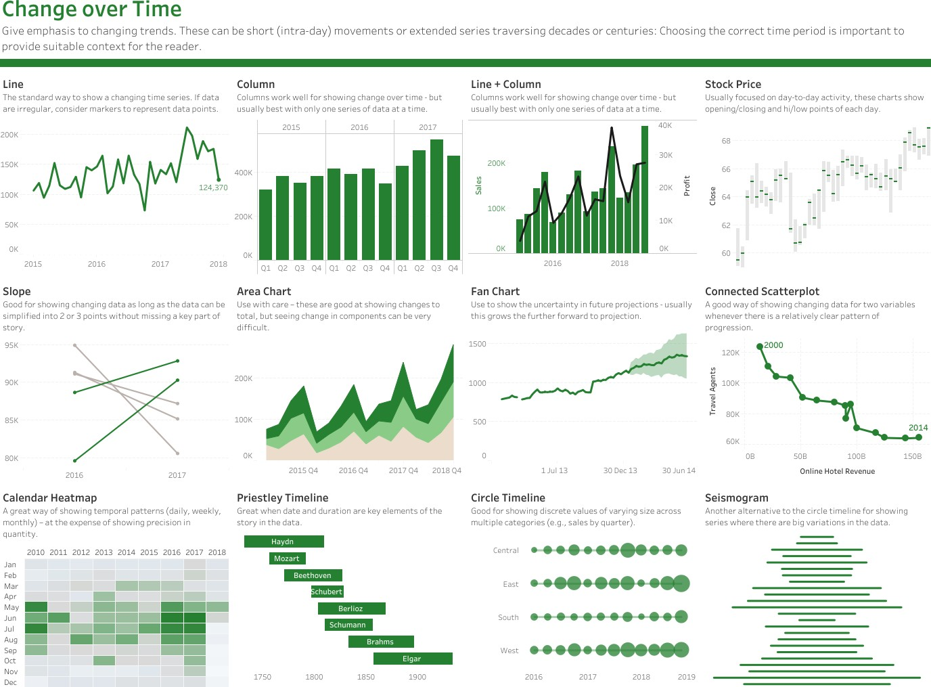

Slide 8
Flow
To display a flow or dynamic relations
1
Waterfall Chart
2
Funnel
3
Flow Map
4
Chord

Slide 9
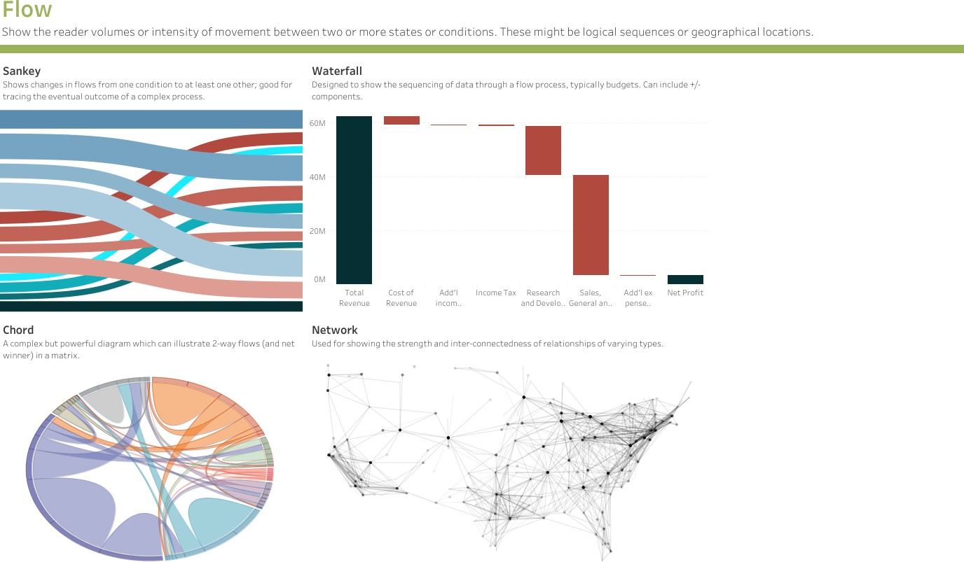

Slide 10
Part-to-whole
To identify the parts making up a measure total
1
Arc
2
Sunburst
3
Waterfall
4
Stacked Bar , Column
5
Pie Chart and Donut Chart

Slide 11
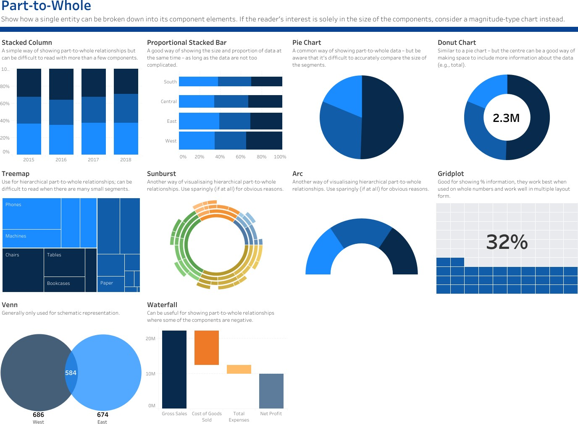

Slide 12
Ranking
To rank measures in an order
1
Funnel
2
Horizontal Bar Chart
3
Clustered Bar chart

Slide 13
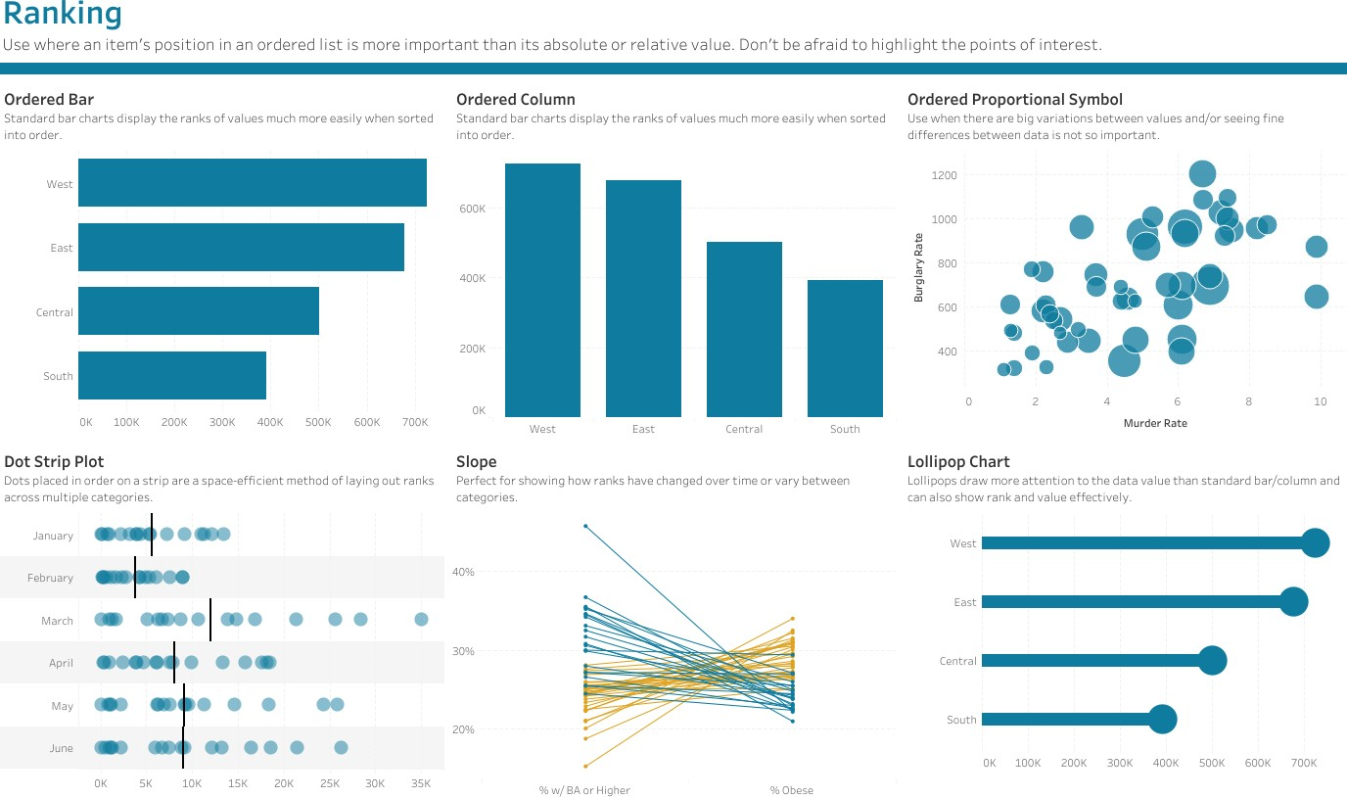

Slide 14
Spatial
To display measures over spatial maps
1
Bing Map
2
Shape Map
3
Azure Map
4
Field Map

Slide 15
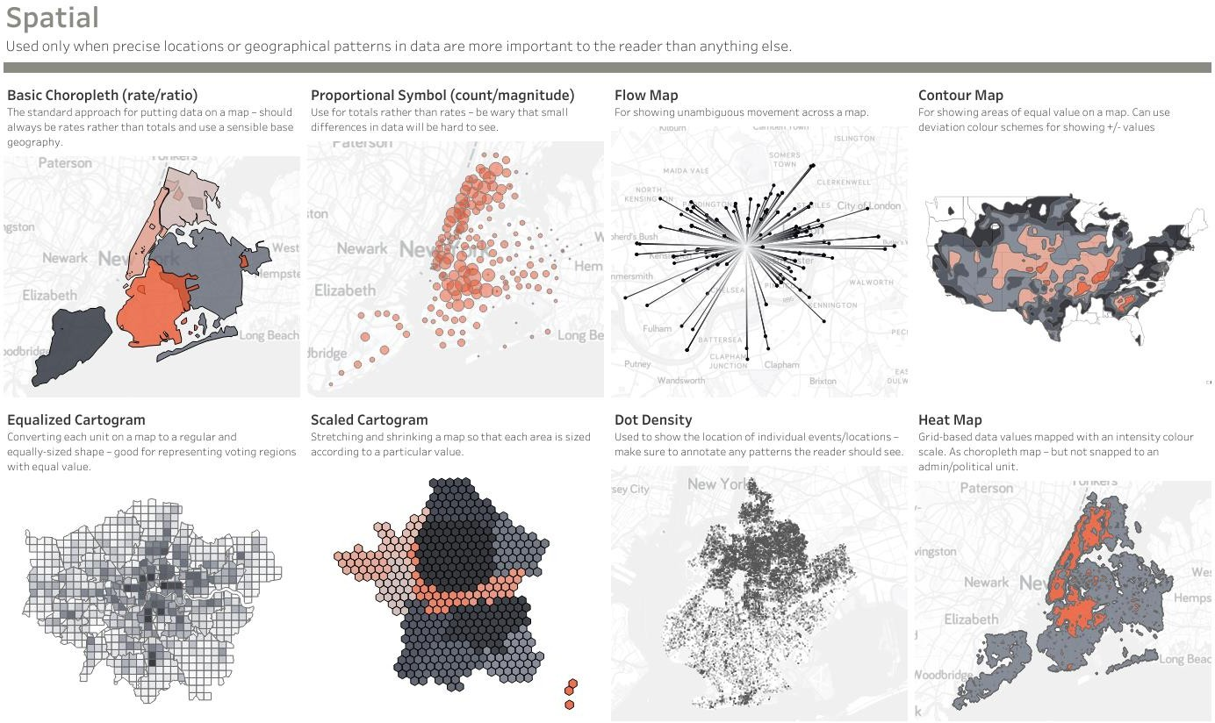

Slide 16
Distribution
To display the distribution of values
1
Column Histogram – Single variable
2
Line Histogram – Single variable
3
Scattered Chart – Two variable
4
3D Area chart – Three variable

Slide 17
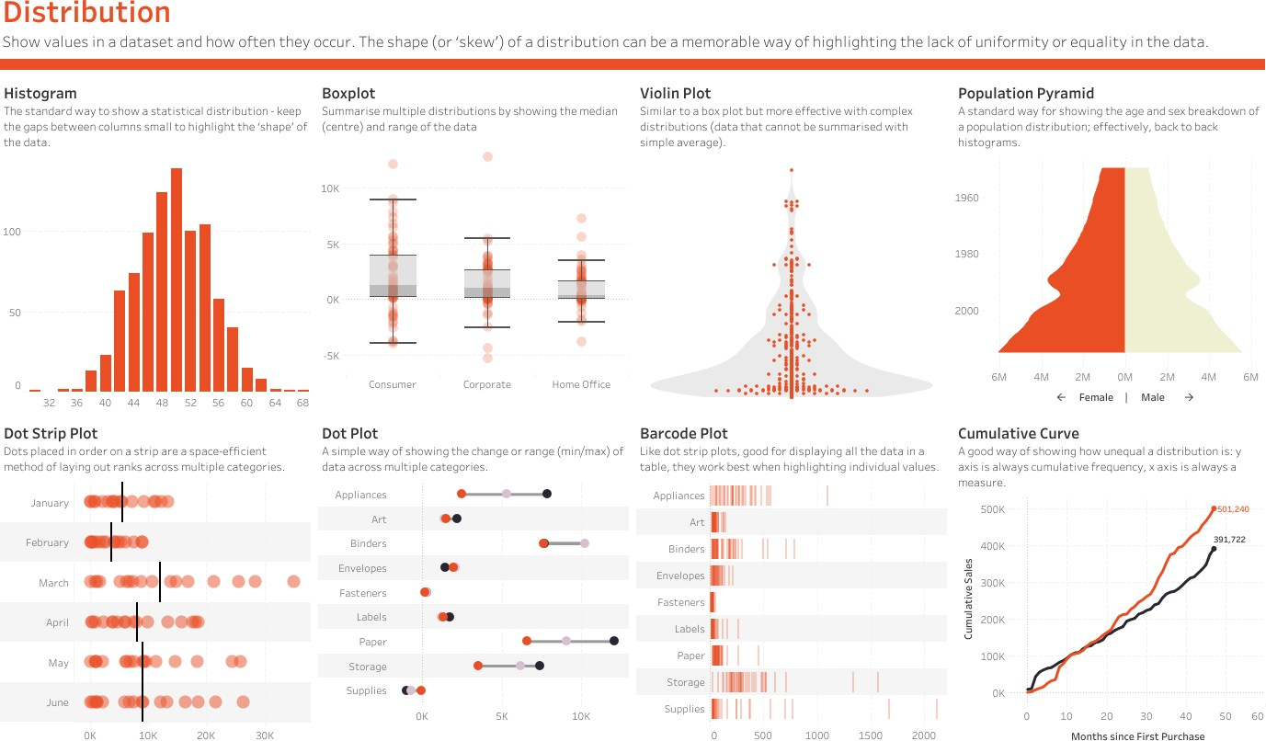

Slide 18
Correlation
To show correlations between measures
1
Scatter Chart
2
Bubble Chart
3
Correlation Plot
4
5

Slide 19
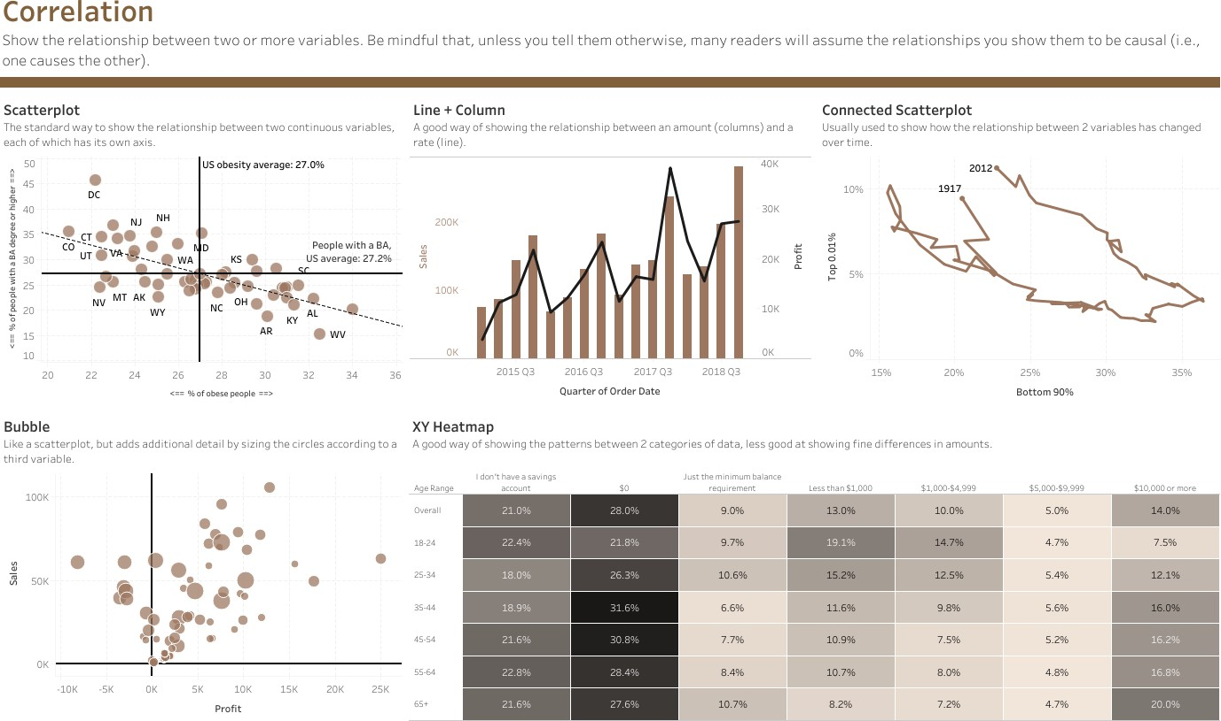

Slide 20
Filter
To control report filters
1
Slicer
2
Text Filter
3
Tassels Parallel Set Slicer
4
Power Slicer
5
Chiclet Slicer

